Slide 1




Equity in post-HCT Survival Predictions
14th QI AI Research-focused Project - Team 3
14th Feb 2025
Group 3 | Final Hackathon
Nahyun Kim, Hanbie Ryu, Jimin Kim, Jaegwan Cho

Slide 2

CONTENTS
Introduction
Dataset
Machine Learning
Model Evaluation
Conclusion

Slide 3
Introduction
Introduction
1.
Introduction
Research Objective
Project Pipeline

Slide 4
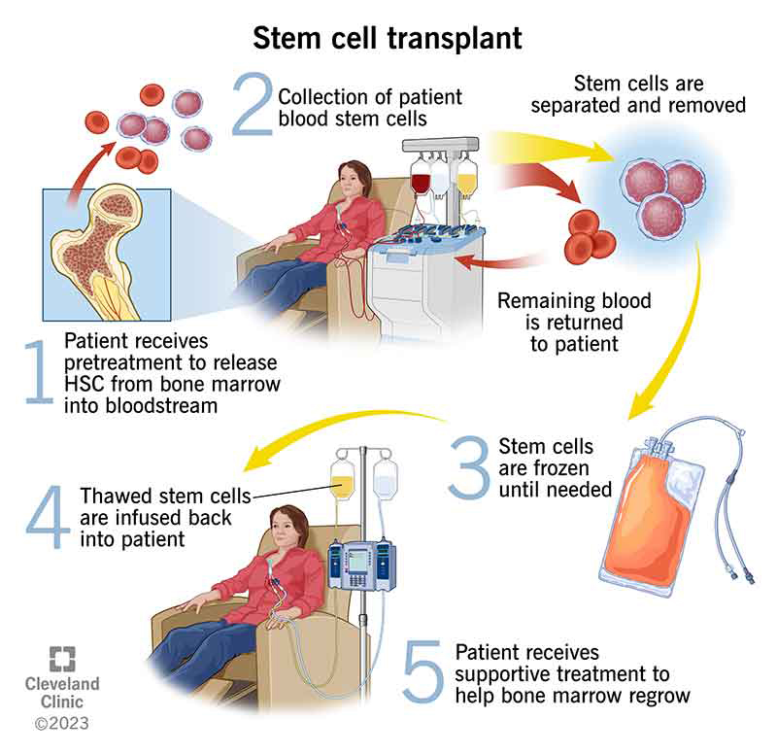
Introduction
Hematopoietic Cell Transplantation - “Bone Marrow Transplant”
Procedure of replacing damaged stem cells with healthy ones from a donor
Blood Cancers
Blood Disorders
Autoimmune Diseases
…

Slide 5
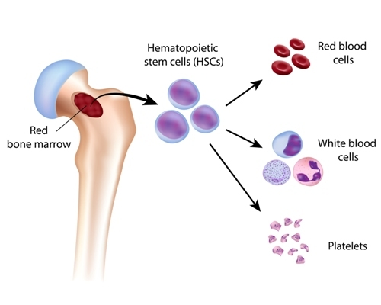

Research Objective
1. Introduction
Synthetic data generated from real patient records (SurvivalGAN) (Norcliffe, 2023)
Censored time-to-event dataset of HCT transplant results
Predict relative risk measurement from patient data
safe
patient [A] data
patient [B] data
patient [C] data
patient [D] data
patient [E] data
high risk

Slide 6
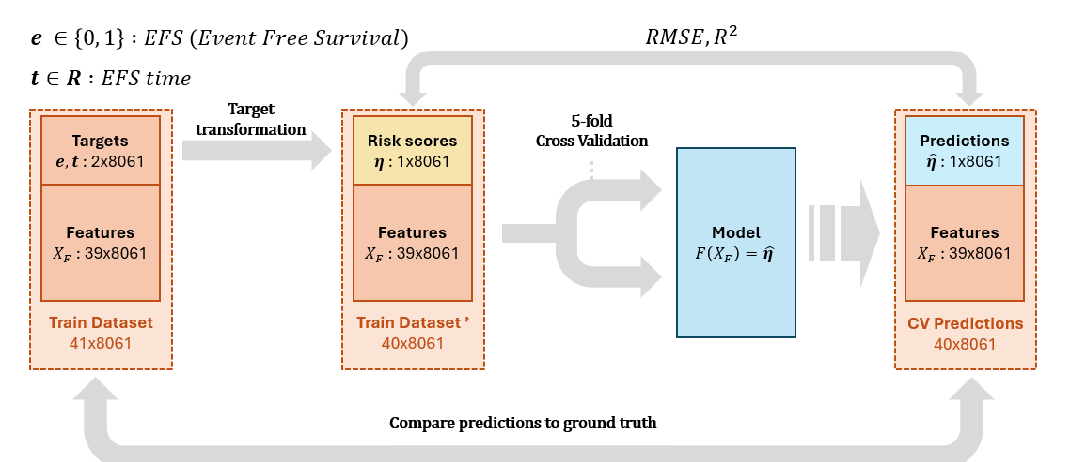
Project Pipeline
1. Introduction
C-index

Slide 7
Dataset
Dataset
2.
Competition Objective
Survival Analysis
Features
Preprocessing

Slide 8
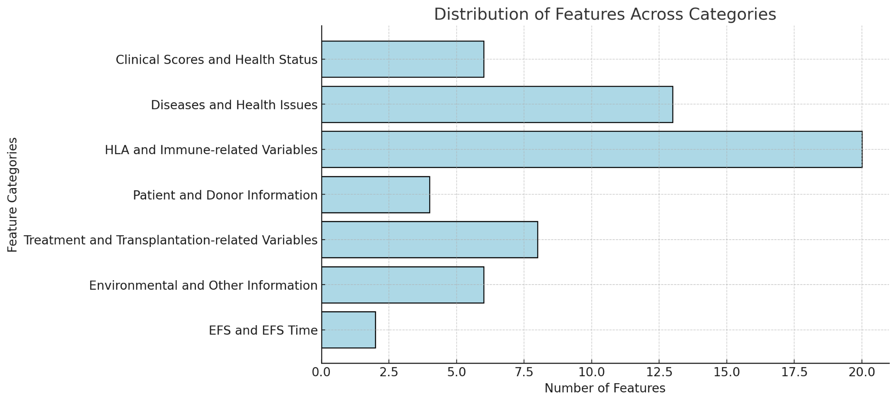
Features
2. Dataset
57 features: Categorical (35) / Numerical (22)

Slide 9
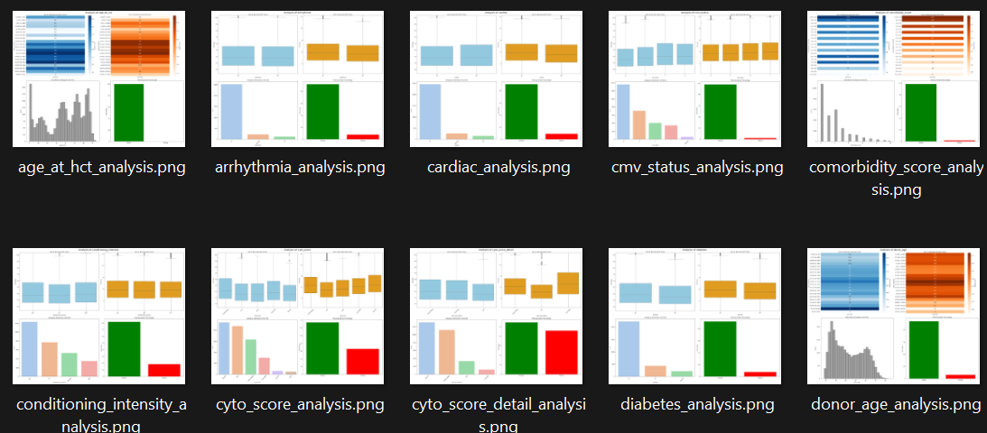
Data Preprocessing
2. Dataset
1. Feature Selection
Analyzed 57 features and selected 39
“% of missing data, high intercorrelation”

Slide 10
Data Preprocessing
2. Dataset
2. N/A Unification
Removed redundant feature values → N/A
Reduced dimensionality → better model efficiency
NULL
‘Not done’
N/A
‘TBD’

Slide 11
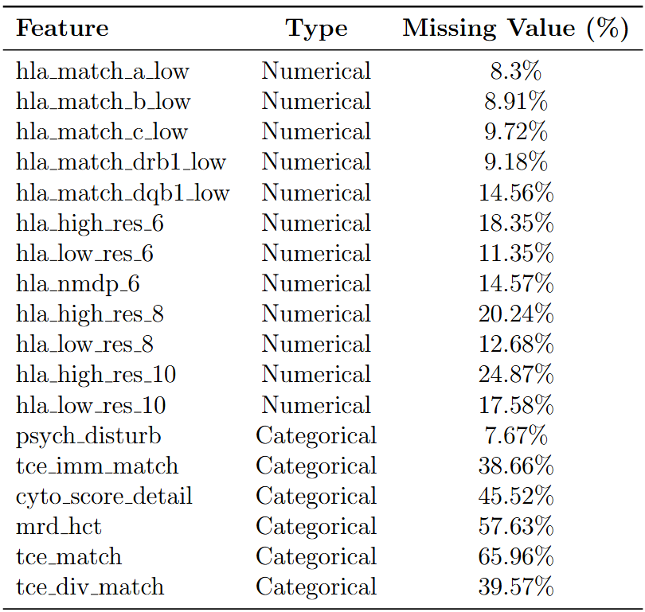
Data Preprocessing
2. Dataset
3. Sample Selection
Removed Features that can be derived from calculations involving other features, such as ‘hla_nmdp_6’
Removed samples with N/A values
Table 1. List of Features Removed
During the Feature Selection Process ▶

Slide 12
Machine Learning
Machine Learning
3.
Competition Objective
Survival Analysis
Model Pipeline
EFS & EFS Time Data
Target Transformation
Model Training

Slide 13
safe
patient [A] data
patient [B] data
patient [C] data
patient [D] data
patient [E] data
high risk

Slide 14
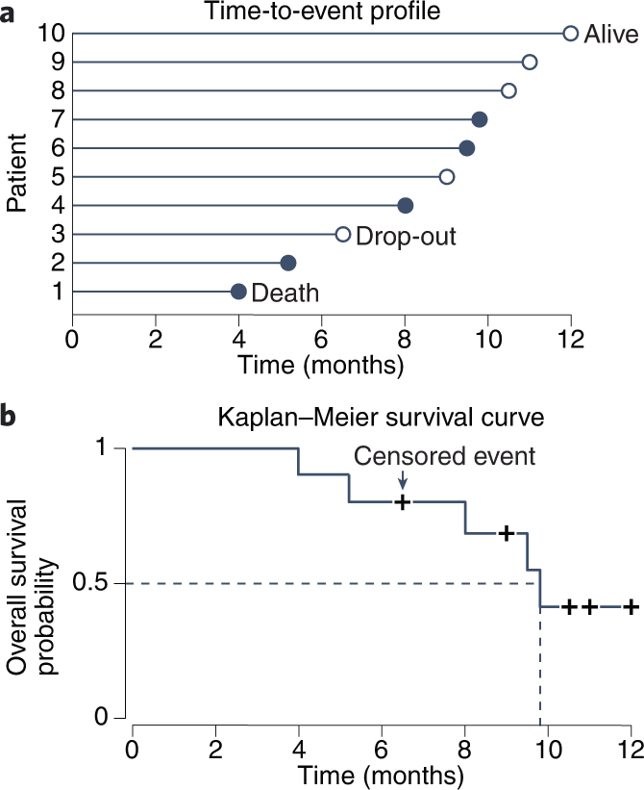
EFS & EFS Time Data
3. Machine Learning
EFS: Event Free Survival → 1: Dead / 0: Censored
EFS Time: Observation time (months)
A : EFS = 1 (Dead) / EFS Time = 30
B : EFS = 1 (Dead) / EFS Time = 90
C : EFS = 1 (Dead) / EFS Time = 2
D : EFS = 0 (Censored) / EFS Time = 200
E : EFS = 0 (Censored) / EFS Time = 40

Slide 15
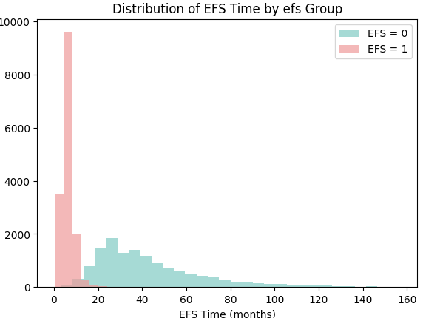
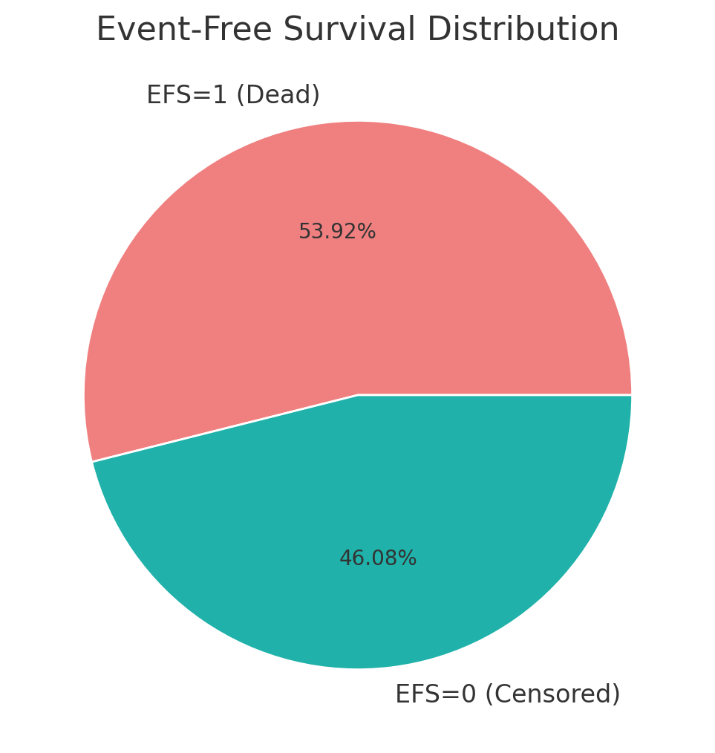
EFS & EFS Time Data
3. Machine Learning
Count

Slide 16
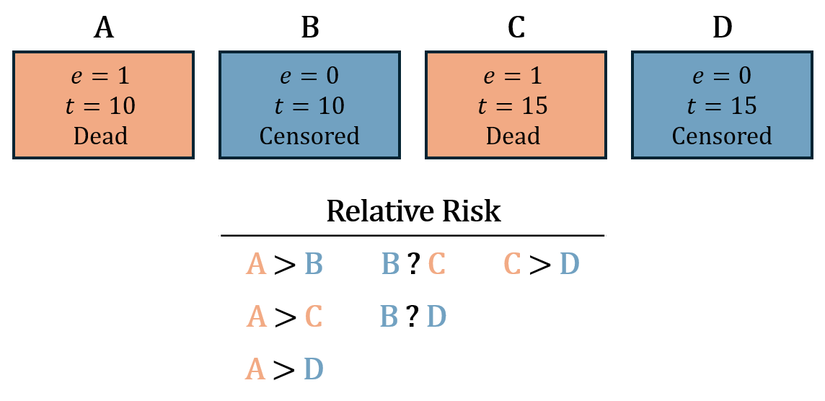
Understanding Relative Risk
3. Machine Learning
Some sample pairs are indecisive like (B , C) / (B , D)

Slide 17
EFS & EFS Time Data
3. Machine Learning
Censored Time-to-Event Data
Risk Scores
[A] EFS + EFS Time
...?
[A] Risk Score
Transform
[B] EFS + EFS Time
[B] Risk Score
[C] EFS + EFS Time
[C] Risk Score
[D] EFS + EFS Time
Transform targets to quantitative Risk Scores
[D] Risk Score
[E] EFS + EFS Time
[E] Risk Score

Slide 18
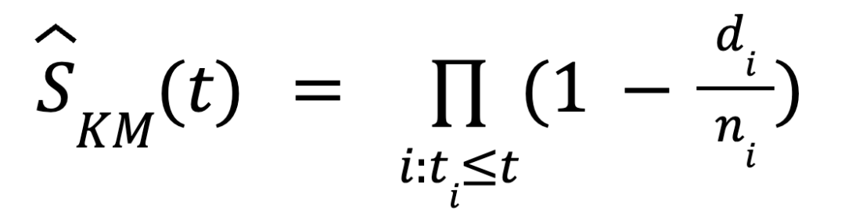
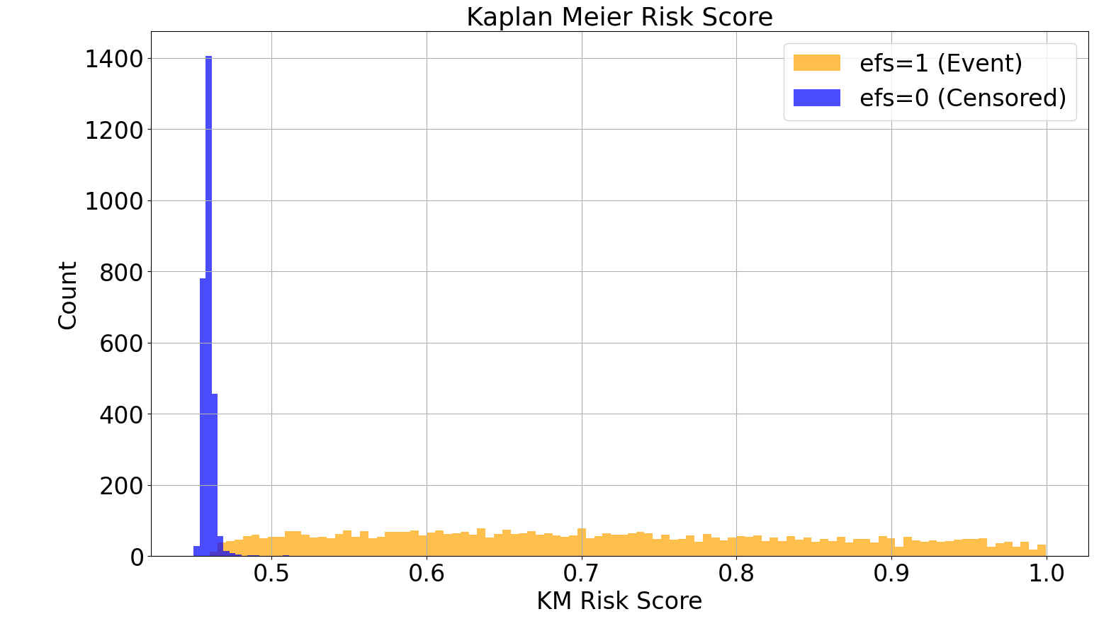
Target Transformation
3. Machine Learning
(1) Kaplan-Meier Target
A. Time-to-event profile
the risk score starts at 1 and approximates to 0
cumulative product when an event occurs
B. Kaplan-Meier Survival Curve

Slide 19
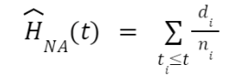
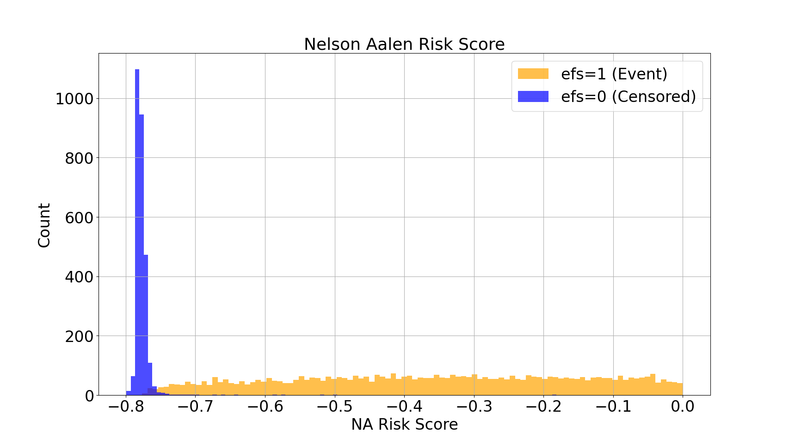
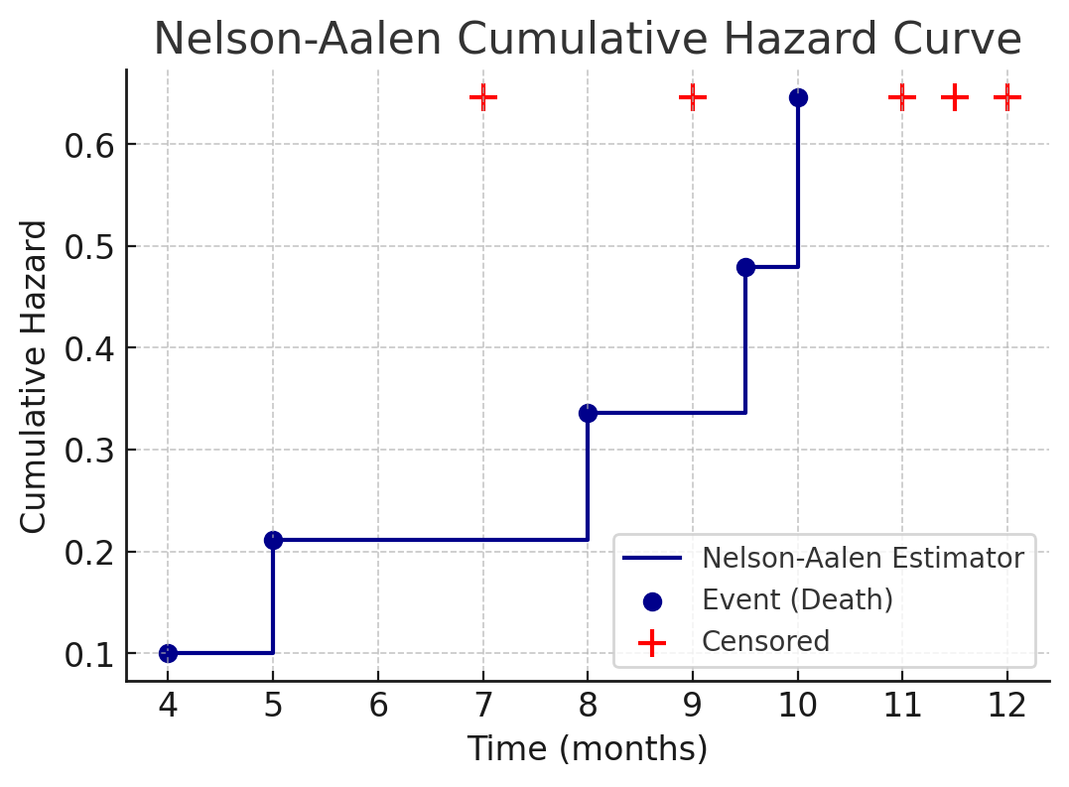
Target Transformation
3. Machine Learning
(2) Nelson-Aalen Target
A. Time-to-event profile
The risk score is simply the negative of the Nelson-Aalen hazard function value
People whose EFS = 0 has less risk score than people whose EFS =1
B. Nelson-Aalen Cumulative Hazard Curve

Slide 20
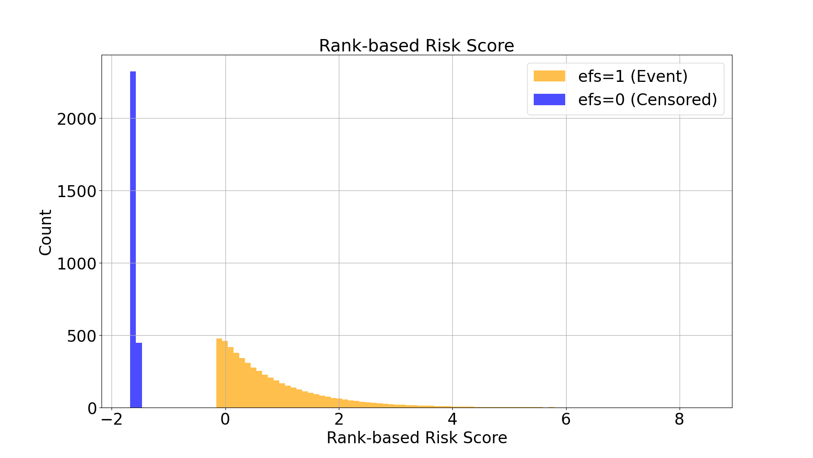



Target Transformation
3. Machine Learning
(3) Rank-based Target
Dr. Chris Deotte
Algorithm 1 Chris Deotte’s Transform, MLP Baseline
INPUT: - EFS_time: List of event times - EFS: List of event indicators (1 = event, 0 = censored) OUTPUT: - risk_scores: Transformed risk scores 1. Shift censored EFS_time: FOR i WHERE EFS[i] == 0: EFS_time[i] += MAX(EFS_time WHERE EFS == 1) - MIN(EFS_time WHERE EFS == 0) 2. Rank EFS_time: ranks = RANK(EFS_time) 3. Offset censored ranks: FOR i WHERE EFS[i] == 0: ranks[i] += 2 * LENGTH(EFS_time) 4. Transform ranks: risk_scores = - LOG(ranks / MAX(ranks)) + MEAN(LOG(ranks / MAX(ranks))) RETURN risk_scores

Slide 21
Model Training
3. Machine Learning
C-index
Put the transformed data into the regression model
- Random Forest w/ 5-fold Cross Validation

Slide 22
Make Predictions
3. Machine Learning
C-index
To make predictions
- EFS, EFS time are not given for input data
- Evaluate RMSE between Target risk scores and Predicted risk scores

Slide 23
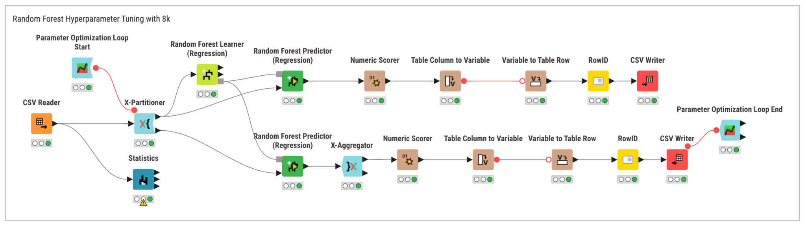
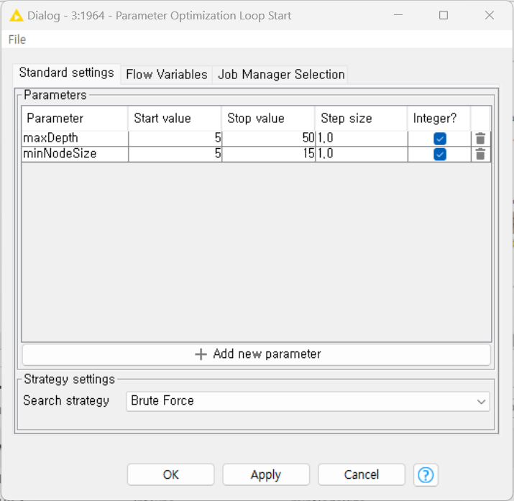
Modeling - Random Forest
3. Machine Learning
5-fold Cross Validation
Separately operated by targets (KM/NA/Rank)

Slide 24
Model Evaluation
Model Evaluation
4.
Competition Objective
Survival Analysis
Model Pipeline
C-index
Performance Evaluation
Model Pipeline

Slide 25
Model Evaluating
4. Model Evaluation
C-index
For model evaluating
- Using EFS, EFS time from the original data, evaluate w/ C-index

Slide 26
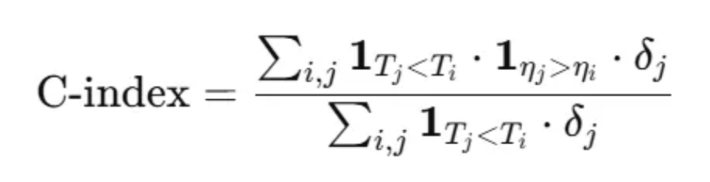
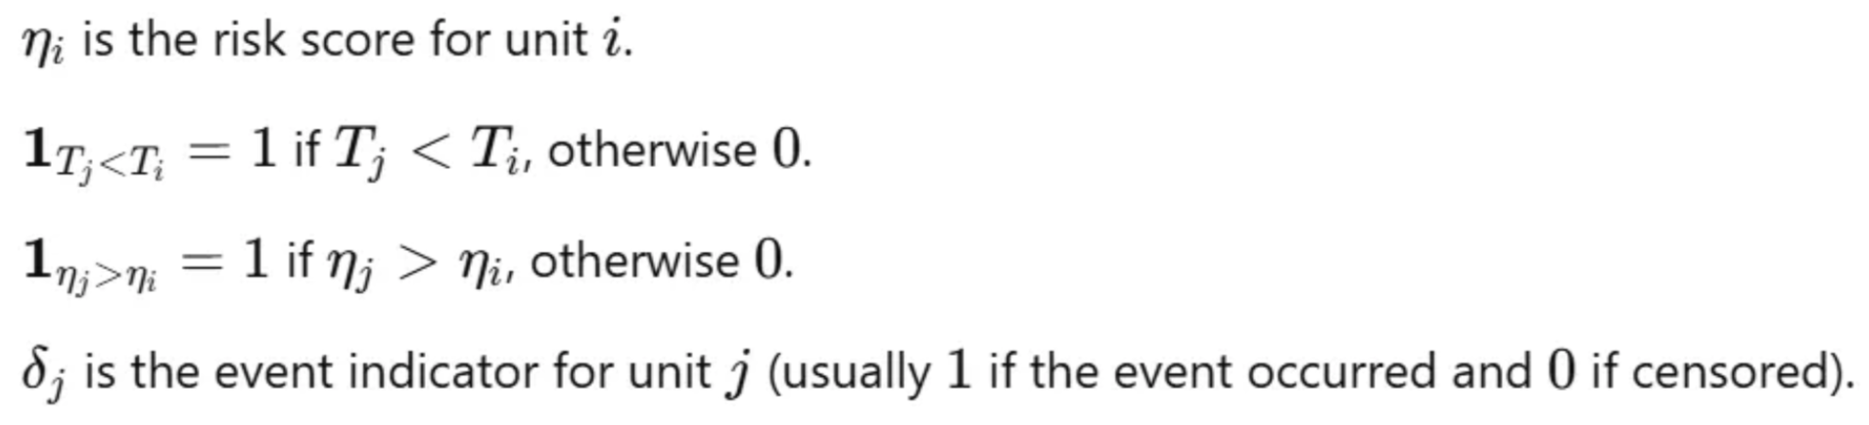
Performance Evaluation - Concordance Index
metric used in survival analysis to measure how well model predicts relative risk
→ evaluates the agreement between event order (GT) and the order of model's risk score (Predictions).
Ground Truth
Predictions
Harrell’s C (Harrell, et al., 1982)
 | EFS | EFS Time
A | 1 | 10
B | 1 | 30
C | 0 | 45
D | 1 | 60
E | 0 | 80
F | 1 | 100
G | 0 | 120
 | Risk
A | 90
C | 80
B | 55
D | 35
G | 18
F | 10
E | 5
C-index: 0.867

Slide 27
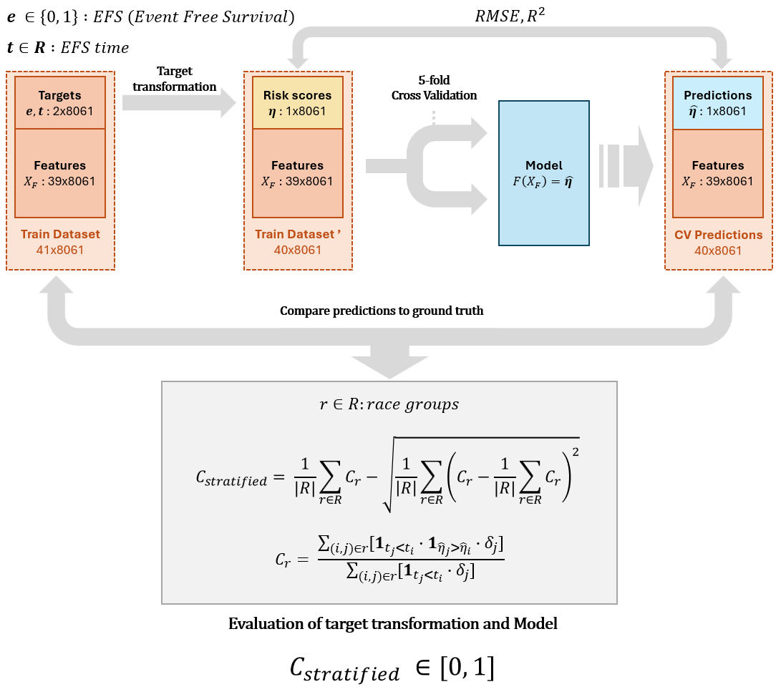

Slide 28
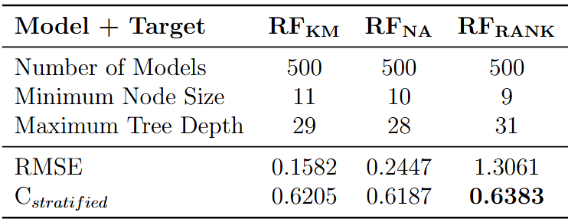
Performance Evaluation
4. Model Evaluation
with RMSE, C-index
Best performance: RF + Rank-based transform
Note) RMSE units differ by target transformations

Slide 29
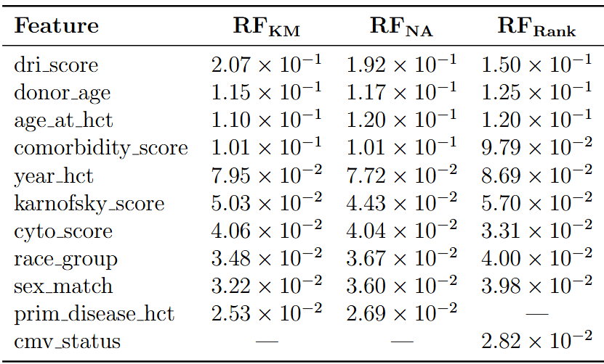
Feature Importance
4. Model Evaluation
Select top 10 features by importance (in optimal RFs) ⇒ Size reduced to 25%
SFD
Selected Feature Dataset
SFD
Selected Feature Dataset

Slide 30
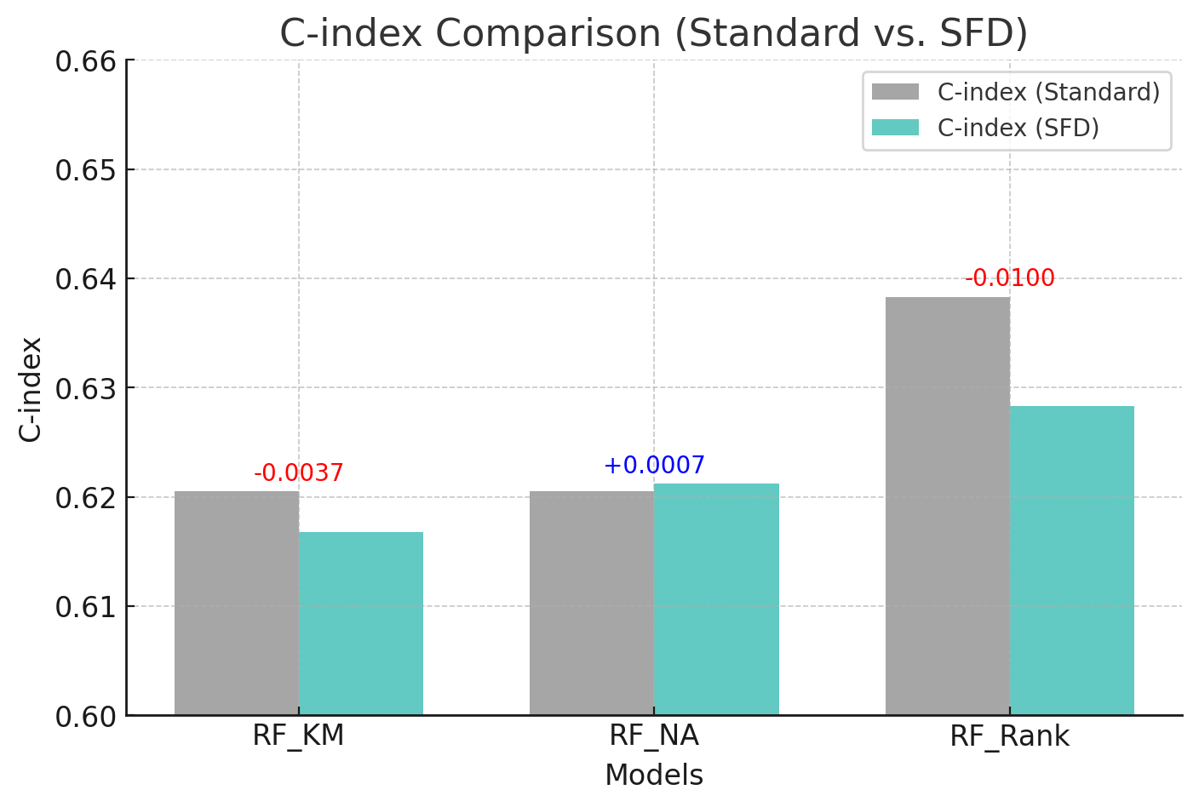
Performance Evaluation in SFD
4. Model Evaluation
Improved model efficiency with SFD
SFD
Selected Feature Dataset
25%
SFD
Selected Feature Dataset

Slide 31
Conclusion
Conclusion
5.
Competition Objective
Survival Analysis
Model Pipeline
Research Significance
Limitations
Future Work

Slide 32
Research Significance
5. Conclusion
: This study introduces risk score prediction for HCT survival analysis using machine learning models and target transformations.
→ Potential for use in medical prognosis
✔ Key Findings
RF + KM had the lowest RMSE (0.1582) → Best for minimizing prediction error.
RF + RANK had the highest C-index (0.6383) → Best for preserving ranking relationships.
Feature importance analysis identified dri_score, donor_age, age_at_hct, and comorbidity_score as key predictors across all models.
Feature selection maintained comparable predictive performance while improving computational efficiency.

Slide 33
Limitations
5. Conclusion
✔ Limited Dataset
The study was conducted on a single dataset, which may limit the generalizability of the findings.
✔ Model Diversity
Only Random Forest was tested.
Other models could offer different insights and performance improvements.
✔ Ensemble Learning Not Explored
The study focused on comparing three target transformation methods (KM, NA, Rank) individually.
A potential ensemble approach combining all three was not tested but could improve predictive robustness.

Slide 34
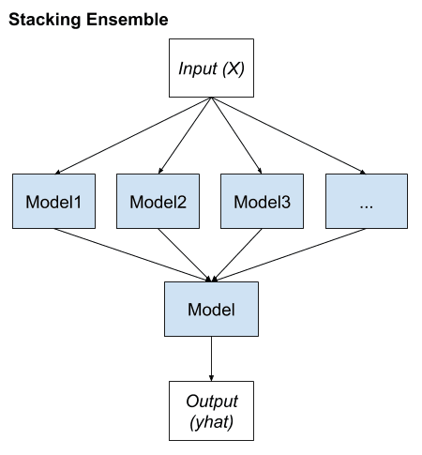
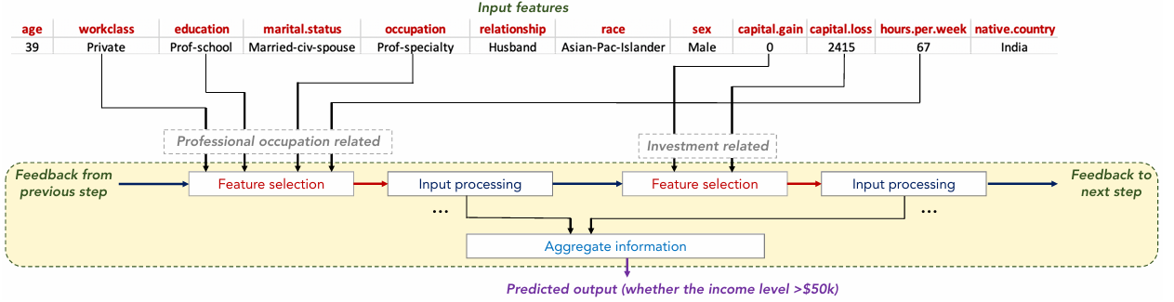
Future Work
5. Conclusion
Ensemble Learning
Deep Learning for Tabular Data
TabM, TabNet vs. XGBoost, LGBM
Machine Learning
Deep Learning

Slide 35
Q & A

Slide 36
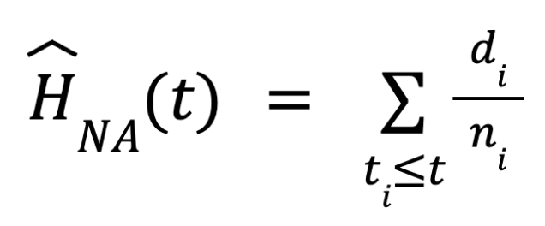
+) Appendix
1. Kaplan-Meier Estimation
2. Nelson-Aalen Estimation
t : Specific time
tᵢ : i-th time point when an event occurs
nᵢ : The number of observed subjects that have not experienced the event until time tᵢ
dᵢ : The number of subjects experiencing the event at time tᵢ

Slide 37
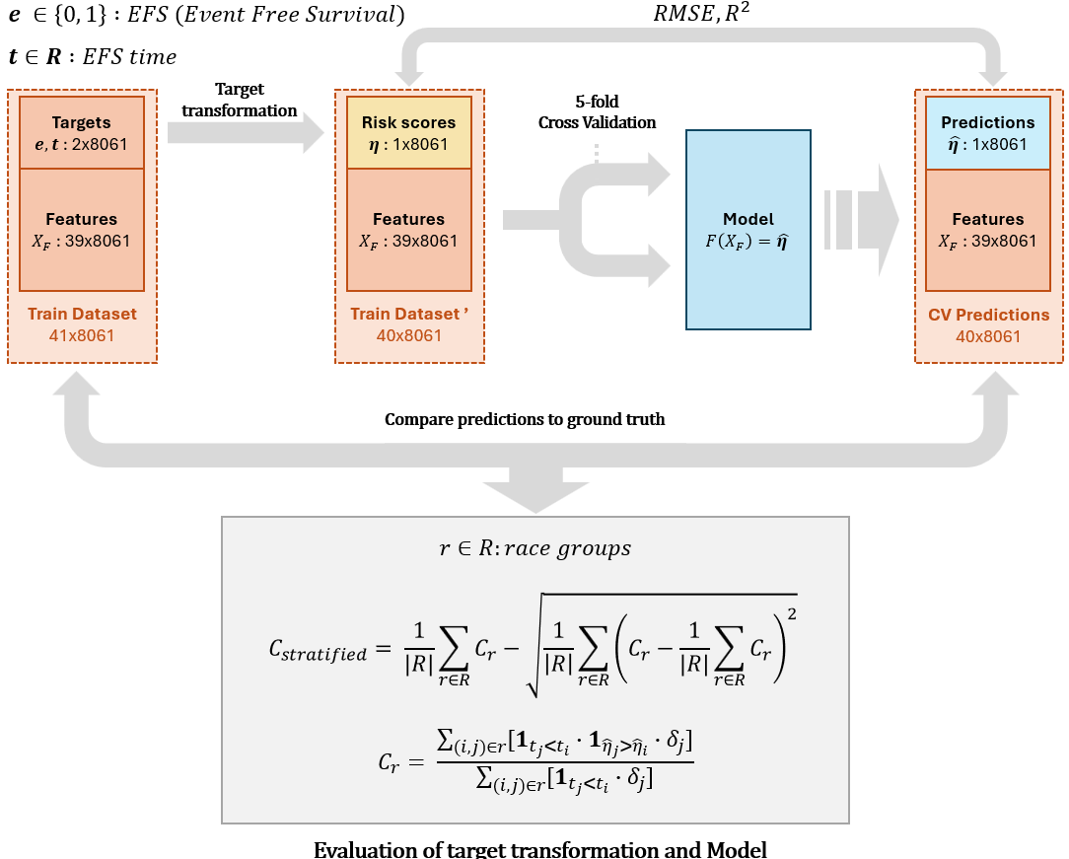
+) Appendix
Project Pipeline

Slide 38
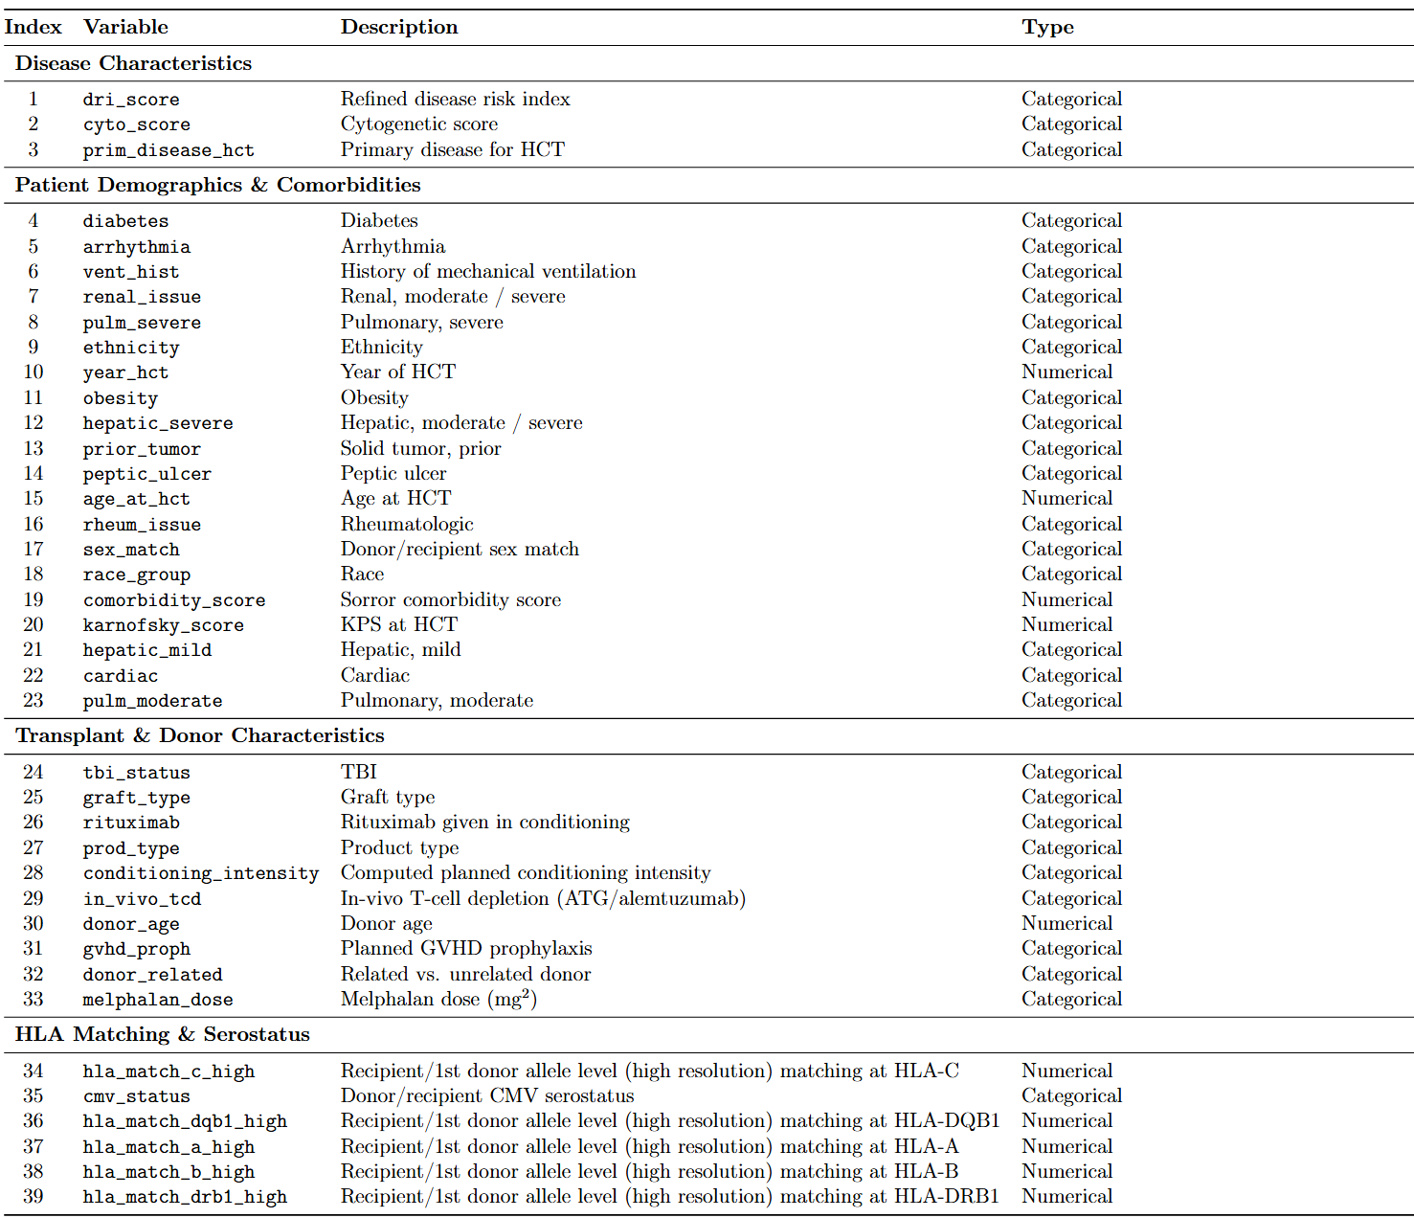
+) Appendix
Feature Dictionary (1)

Slide 39
+) Appendix
Feature Dictionary (2)

